Slide 1

50.051 Programming Language Concepts W5-S2 Regular Expressions and Pattern Recognition in C
Matthieu De Mari

Slide 2
Regular Expressions
Definition (Regular Expressions, or RegEx):
Regular Expressions (or Regex) are a powerful tool for pattern matching and searching in text.
They are used in many programming languages and applications to find, extract, and manipulate text based on specific patterns.
Regular expressions can be seen as a concise way of describing a set of strings that share a certain structure or patterns.
Later on, RegEx will be very useful for our compilers to recognize substrings of text that exhibit a certain pattern (e.g. they consist of a certain keyword, start/end with a certain character, etc.).

Slide 3
Regular Expressions
Definition (Regular Language):
Regular Language consists of the possible strings that exhibit the pattern defined by a given Regular Expression.
For instance, if the Regular Expression describes all the binary strings finishing with a 0…
…Then, all of these strings (100, 10100, 1110, 10, 1101010011010, etc.) will be considered Regular Language for the given Regular Expression we have defined above.

Slide 4
Technically, we have already played with RegEx FSMs! (Remember previous activities).
Can we use an FSM to implement a RegEx?
Yes!
Our Finite State Machines (FSM) from the previous lecture will be used to recognize regular languages, which are sets of strings that can be described by regular expressions.
There is a strong connection between regular expressions and FSMs: for every regular expression, there exists an equivalent FSM that recognizes the same language. And vice versa.

Slide 5
Technically, we have already played with RegEx FSMs! (Practice 1).
We would like to write an FSM with stopping states that will take strings x consisting of combinations of three characters: Z, A and M.
Possible combinations for the string x include, among many others, “ZAM”, “AMAZ”, “ZAMZAM”, etc.
Q1: Draw the FSM state diagram, where the FSM will accept an input string x, if and only if the string x contains the substring ZAM.
Q2 (cannot be solved for now, get back to it later): Could that be described using a RegEx of some sort?

Slide 6
The most basic RegEx
Definition (the most basic RegEx):
The most basic regex attempts to recognize a string x containing a single letter, e.g. "a".
Any string that contains a (for instance, “a”, “aa”, “ba”, “singapore”, etc.) is then considered as regular language for this regular expression.
This regular expression is then simply denoted as “a”.

Slide 7
The most basic RegEx
This can be simply implemented using an FSM with outputs, as shown.
The FSM uses outputs and will stop early when an output 1 is produced.
The only acceptable input strings, will therefore be the ones that produce a 1 output at some point.
Any character/1
VALID
NOT VALID
a/1
Anything but a/0

Slide 8
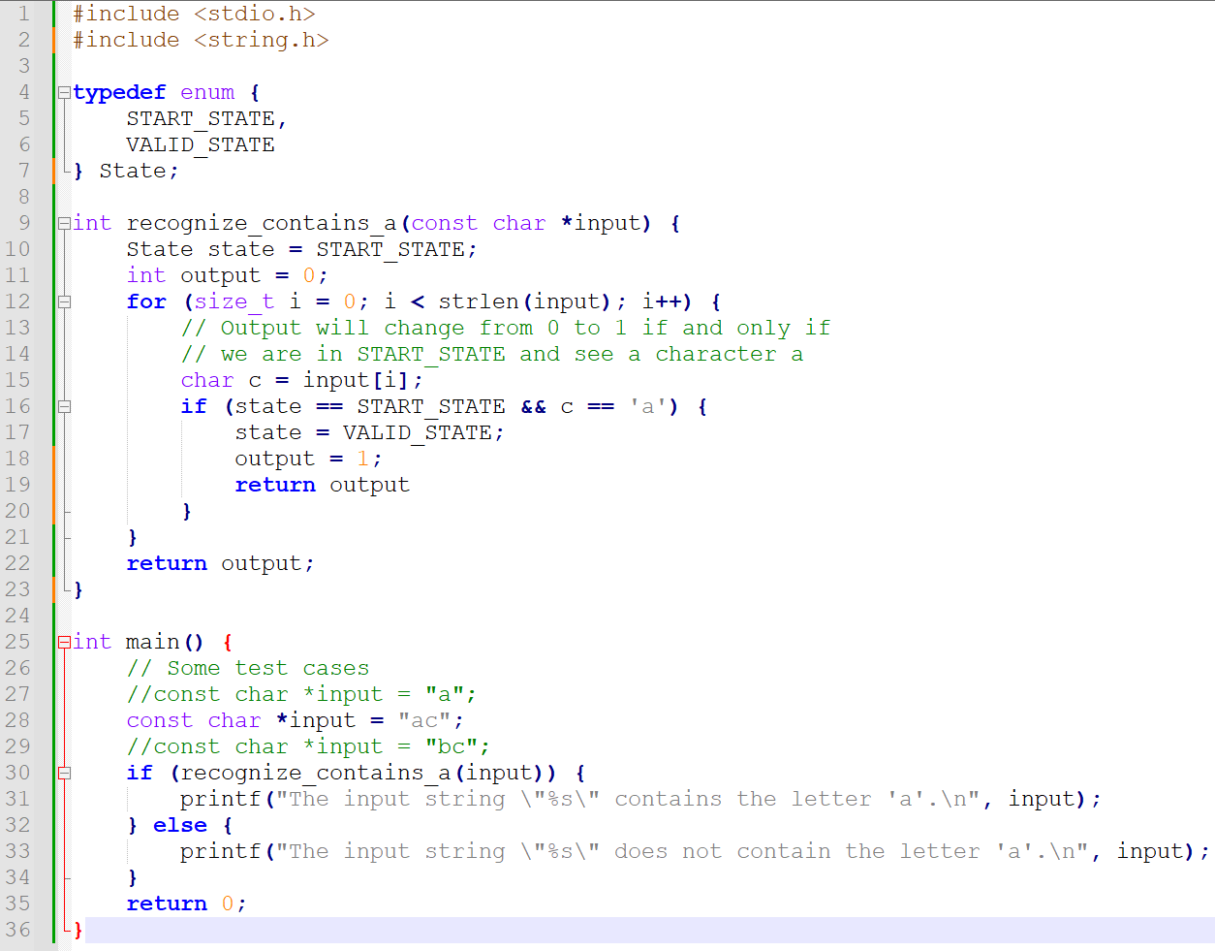

Slide 9
The most basic RegEx
This can also be implemented as an FSM with a single stopping state being VALID.
We can even decide to stop the FSM prematurely if the next state being produced at any given time is VALID.
This is roughly equivalent.
Any character
VALID
NOT VALID
VALID
a
Anything but a

Slide 10
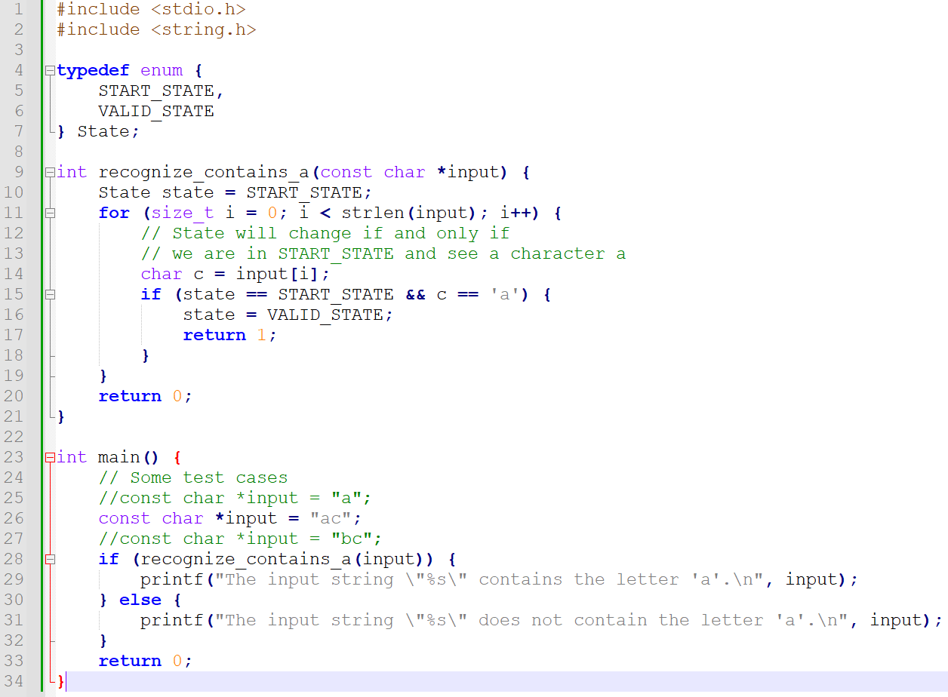

Slide 11
The infamous Epsilon transition
Definition (the Epsilon transition):
In (Non-deterministic) Finite State Machines, the Epsilon transition is an optional transition which offers to advance to a next state, without consuming any character from the input string s.
In Layman terms, an epsilon transition literally means “you may choose to go to the next state (or not) without using the next input character yet”.
Important note: When using an Epsilon transition, you do NOT skip the current input character. It is simply a free transition you may or may not decide to use when given the opportunity.

Slide 12
About the Non-Deterministic FSMs
Definition (Non-Deterministic Finite State Machines):
The Epsilon transitions are optional, and you may or may not decide to take them at a given time.
This basically means that for a given input string x, there might be multiple possible paths in the FSM that can be taken.
These types of FSM are commonly referred to as Non-Deterministic Finite State Machines, or NDFSM.
A given NDFSM will then consider a string x to be acceptable if and only if there exists at least one path in the FSM that satisfies conditions in terms of stopping states or valid outputs being produced.

Slide 13








A use case for Epsilon (Practice 2)
$$0 or 1$$
As an example of the use for the Epsilon transition, consider the NDFSM on the right.
Question: What are acceptable inputs for this NDFSM?
NOT VALID
$$0 or 1$$
$$0$$
$$1$$
$$0$$
s3
s2
s1
s0
VALID
$$0$$
$$1$$
$$ε$$
1

Slide 14
A use case for Epsilon (Practice 2)
$$0 or 1$$
As an example of the use for the Epsilon transition, consider the NDFSM on the right.
Question: What are acceptable inputs for this NDFSM?
Answer: Any string that consists of any number of ones (but at least one), and then finishes with exactly one zero (e.g. 10, 110, 1110, 111111110, etc.)
NOT VALID
$$0 or 1$$
$$0$$
$$1$$
$$0$$
s3
s2
s1
s0
VALID
$$0$$
$$1$$
$$ε$$
1

Slide 15
On the use of the Epsilon Transitions in RegEx
Definition (Epsilon transitions in RegEx):
One important use of epsilon transitions is in the construction of NDFSMs for RegEx.
In this context, an epsilon transition can typically be used to represent the empty string, which is often considered a valid input for many regular expressions.
By including epsilon transitions in the FSM of your RegEx,
the regular expression can be represented more simply,
and you may use it to combine several RegEx into a single combined one (as will be shown next).

Slide 16
Concatenation of RegEx
Any character
VALID
NOT VALID
VALID
Theorem (Concatenation of RegEx):
Assume that we have two RegEx, e.g.
our first RegEx is “a”
and our second RegEx is “b”,
and we have defined their respective two FSMs.
a
Anything but a
Any character
VALID
NOT VALID
VALID
b
Anything but b

Slide 17

Concatenation of RegEx
a
Anything but a
1
Anything but a or b
0
Theorem (Concatenation of RegEx):
Assume that we have two RegEx, e.g.
our first RegEx is “a”
and our second RegEx is “b”,
and we have defined their respective two FSMs.
The concatenated RegEx “ab”, which accepts strings containing the substring “ab”, can then be built by combining the two FSMs, connecting them with an Epsilon transition.
a
$$ε$$
Anything but b
Any character
VALID
2
3
b

Slide 18
Concatenation of RegEx
a
Anything but a
1
Anything but a or b
0
Question: Could we transform our NDFSM into a DFSM if we
merge both states 1 and 2 together,
to get rid of the Epsilon transition here,
And still obtain the expected RegEx that we want?
(Theorem: Any NDFSM can be transformed into a DFSM.)
a
$$ε$$
Anything but b
Any character
VALID
2
3
b

Slide 19
Concatenation of RegEx
a
Anything but a
1
Anything but a or b
0
Question: Could we transform our NDFSM into a DFSM if we
merge both states 1 and 2 together,
to get rid of the Epsilon transition here,
And still obtain the expected RegEx that we want?
Would that be valid?
a
b
VALID
2
Any character

Slide 20
Back to our Practice 1
We would like to write an FSM with stopping states that will take strings x consisting of combinations of three characters: Z, A and M.
Possible combinations for the string x include, among many others, “ZAM”, “AMAZ”, “ZAMZAM”, etc.
Draw a FSM state diagram, which has the FSM produce a specific output, if and only if the string x contains the substring ZAM.
Q2 (can probably be solved now): Could that be described using a RegEx of some sort?

Slide 21
Choice of RegEx
Theorem (Choice operator in RegEx):
Assume that we have two RegEx, e.g.
our first RegEx is “a”
and our second RegEx is “b”,
and we have defined their respective two FSMs.
The choice operator | between both RegEx “a|b” is used to define the union of two regular language consisting of the two strings “a” and “b”.
Its regular language consists of the union set of strings that the letter a, strings that contain the b, and strings that contain both.

Slide 22
Choice of RegEx
Any character
VALID
NOT VALID
VALID
As before it is possible to build the FSM for “a|b” by
combining the two FSMs for “a” and “b”,
in parallel, this time,
connecting them with Epsilon transitions.
a
Anything but a
Any character
VALID
NOT VALID
VALID
b
Anything but b

Slide 23


Choice of RegEx
Any character but a or b
1
0
As before it is possible to build the FSM for “a|b” by
combining the two FSMs for “a” and “b”,
in parallel, this time,
connecting them with Epsilon transitions.
(Note: Each state 1, 2, 3 has self-links matching any character, removed for simplicity.)
a
$$ε$$
b
3
$$ε$$
2
3

Slide 24
Choice of RegEx
Any character but a or b
1
0
Quick question: Again, could we transform our NDFSM into a DFSM if we decide to
merge states 1, 2 and 3 together,
to get rid of the Epsilon transitions here,
And still obtain the expected RegEx that we want?
a
$$ε$$
b
3
$$ε$$
2
3

Slide 25
Choice of RegEx
0
Quick question: Again, could we transform our NDFSM into a DFSM if we decide to
merge states 1, 2 and 3 together,
to get rid of the Epsilon transitions here,
And still obtain the expected RegEx that we want?
Would this work?
a or b
3
3
Any character

Slide 26
On the use of parentheses in RegEx
Definition (On the use of parentheses in RegEx):
Parentheses can be used in RegEx to separate operations.
For instance, we could write the RegEx “(a|b)c”, whose acceptable language consists then of all the substrings containing either one of the two strings “ac” and “bc”.
It should not be confused with “a|bc”, whose regular language is then consisting of all the substrings containing either one of the two strings “a” and “bc”.
In this second case, a|bc is equivalent to a|(bc).

Slide 27
On the use of the escape character in RegEx
Definition (On the use of the escape character in RegEx):
The Escape character \ can be used in RegEx to indicate that a special symbol (or something we call a metacharacter in RegEx) – which normally has an effect in RegEx – should in fact appear in the string.
For instance, we could write the RegEx “\(a\)c”, whose regular language consists then of all the strings containing the substring “(a)c”.
In this case, the parentheses symbols now being treated as characters to appear in a given input string x.

Slide 28
Closure or Kleene operator
Theorem (Closure or Kleene operator in RegEx):
Assume that we have a RegEx “a” and its respective FSM.
The Closure (or Kleene) operator * is used to define the RegEx “a*”.
Its regular language consists of all the strings containing zero or more repetitions of the character a, for instance “”, “a”, “aa”, “aaa”, “aaaaaaaaaaaaaaaaaaaaaaa”, etc.

Slide 29
Closure or Kleene operator
Theorem (Closure or Kleene operator in RegEx):
Assume that we have a RegEx “a” and its respective FSM.
The Closure (or Kleene) operator * is used to define the RegEx “a*”.
Its regular language consists of all the strings containing zero or more repetitions of the character a, for instance “”, “a”, “aa”, “aaa”, “aaaaaaaaaaaaaaaaaaaaaaa”, etc.
Crazy Question: Does that mean that “c” would match “a*”, as it contains zero repetitions of the character “a”?!

Slide 30
An important note: partial vs full matching
It is important to note that, we often consider partial matching (or substring matching) when our RegEx consists of basic operation combined with concatenation and/or choice operations.
Once a Kleene operator appears, it is often preferable to consider full string matching instead.
If full string matching is considered, then the RegEx “a*” would only match an empty string or strings that are composed exclusively of the letter 'a', such as "a", "aa", "aaa", etc.
It would not match "aaaab" or "baaa" because these strings contain additional characters beyond just 'a'.

Slide 31
Full string matching vs. substring matching
Definition (Full String Matching):
Full string matching, also known as exact matching, is when the RegEx is used to match an entire string from start to finish without any extra characters before or after the pattern.
This means that the entire string must conform exactly to the pattern described by the RegEx for a match to be considered part of its regular language.
If full string matching is considered, then it would only match an empty string or strings that are composed exclusively of the letter 'a', such as "a", "aa", "aaa", etc. It would not match "aaaab" or "baaa" because these strings contain additional characters beyond just 'a'.

Slide 32
Full string matching vs. substring matching
Definition (Partial String Matching):
Substring matching, on the other hand, involves checking if there are at least one occurrence of the pattern within a larger string.
The RegEx engine searches through the string and matches any part of it that conforms to the regex pattern, regardless of what characters may be present before or after the match.
If partial matching (or substring matching) is considered, then “a*” would match any other characters than the sequence of “a” characters. This means that “aaaab” or “caa” would be accepted as regular language for “a*”.

Slide 33
Closure or Kleene operator
Theorem (Closure or Kleene operator in RegEx):
Assume that we have a RegEx “a” and its respective FSM.
The Closure (or Kleene) operator * is used to define the RegEx “a*”.
Its regular language consists of all the strings containing zero or more repetitions of the character a, for instance “”, “a”, “aa”, “aaa”, “aaaaaaaaaaaaaaaaaaaaaaa”, etc.
Crazy Question: Does that mean that “c” would match “a*”, as it contains zero repetitions of the character “a”?!
→ So how to control if full string matching or partial matching then?

Slide 34
Beginning (^) and End ($) of a string
In RegEx, the caret (^) and dollar sign ($) are both metacharacters that represent the beginning and end of a string, respectively.
^: The caret (^) denotes the beginning of a string.
$: The dollar sign ($) denotes the end of a string.
E.g., the regex ^a (resp. a$) matches any string that starts (resp. ends) with "a".
For instance,
The regex ^abc$ accepts only the string "abc", but not "aabc", "abcc", or “abcabc".
The regex ^abc checks for "abc" at the beginning of a string. It accepts "abcd" but will not accept "aabc".
The regex abc$ matches "abc" at the end of a string. Same idea as above.

Slide 35
Full string matching vs. substring matching
In the context of regex, full string matching is often implemented by anchoring the regex pattern to the beginning and end of the string using the caret (^) and dollar sign ($) respectively.
For example, the regex pattern ^a*$ would match an empty string or any string that is composed exclusively of the letter 'a', such as "a", "aa", "aaa", etc., but it would not match "aaaab" or "baaa" because these st On the other hand, the regex pattern a* without anchors would implement partial matching. It would find matches within any string that contains the letter 'a'. In "aaaab", it would match "aaaa", and in "caa", it would match "aa".

Slide 36
Closure or Kleene operator
Theorem (Closure or Kleene operator in RegEx):
Assume that we have a RegEx “a” and its respective FSM.
The Closure (or Kleene) operator * is used to define the RegEx “a*”.
Its regular language consists of all the strings containing zero or more repetitions of the character a, for instance “”, “a”, “aa”, “aaa”, “aaaaaaaaaaaaaaaaaaaaaaa”, etc.
Using the Regex “a*” suggests that we use partial matching.
On the other hand, using “^a*$” suggests a full string matching.

Slide 37

Closure or Kleene operator
The FSM for “^a*$”, in the case of full string matching, is again, based on the one for “a” and is shown.
In that case, the use of epsilon is necessary to match the empty string as a possible regular language for “a*”.
Anything but a
s0
1
0
$ε$or a

Slide 38
Variations of the Kleene operator
Theorem (Plus or Kleene Plus operator in RegEx):
Assume that we have a RegEx “a” and its respective FSM.
The Plus (or Kleene Plus) operator + is used to define the RegEx “a+”.
Its regular language, in full string matching, consists of all the strings containing of one or more repetitions of the character a, i.e. “a”, “aa”, “aaa”, “aaaaa”, etc.
The RegEx “a+” is a shorter notation equivalent to “aa*”.

Slide 39
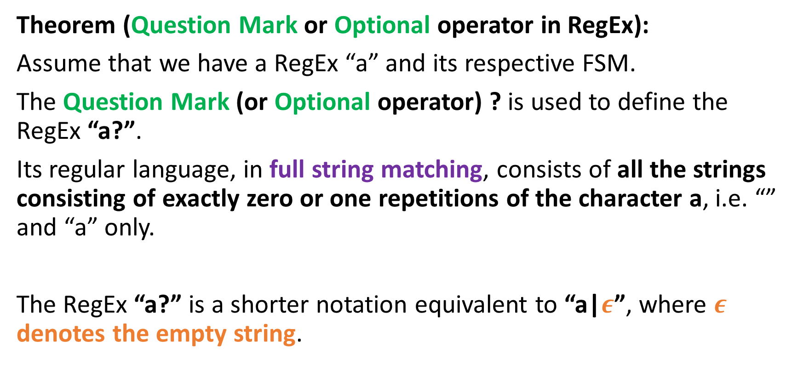
Variations of the Kleene operator
Theorem (Question Mark or Optional operator in RegEx):
Assume that we have a RegEx “a” and its respective FSM.
The Question Mark (or Optional operator) ? is used to define the RegEx “a?”.
Its regular language, in full string matching, consists of all the strings consisting of exactly zero or one repetitions of the character a, i.e. “” and “a” only.
The RegEx “a?” is a shorter notation equivalent to “a|$ε$”, where $ε$ denotes the empty string.

Slide 40
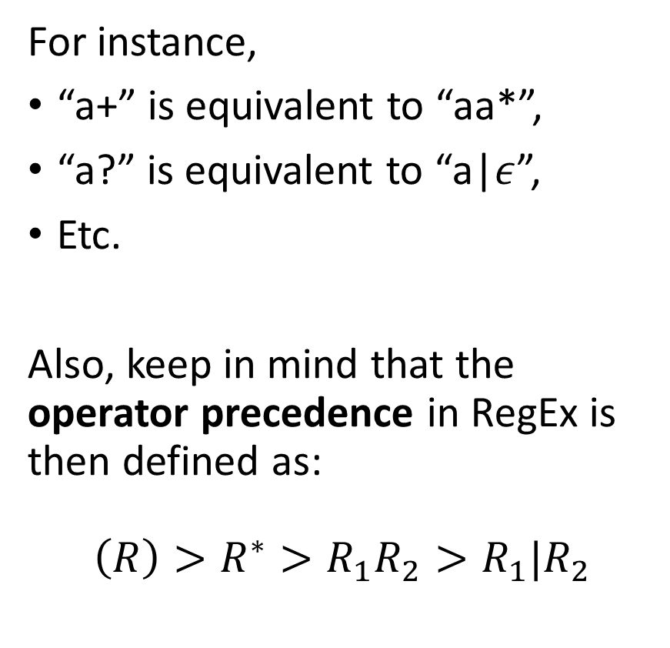
The Kleene Theorem
Theorem (The Kleene Theorem):
The three fundamental operators we have defined earlier:
Concatenation “ab”,
Choice “a|b”
And Kleene “a*”,
(Along with the Epsilon symbol,)
can be used to define every other operation in RegEx.
For instance,
“a+” is equivalent to “aa*”,
“a?” is equivalent to “a|$ε$”,
Etc.
Also, keep in mind that the operator precedence in RegEx is then defined as:
$$\left(R\right)>R^{∗}>R_{1}R_{2}>R_{1}|R_{2}$$

Slide 41
Quiz Time!
Which regular expression would be the best to match the two strings "cat" and "bat"?
^(c|b)at$
^(c|b)?at$
^(c+b)at$
^(c|b)+(at)$

Slide 42
Quiz Time!
Which regular expression would be the best to match the two strings "cat" and "bat"?
^(c|b)at$
^(c|b)?at$
^(c+b)at$
^(c|b)+at$
(Some others could work but they are terrible malpractice, so not going to accept them)

Slide 43
Quiz Time!
What does the Kleene star (*) operator represent in regular expressions?
Match exactly one character
Match zero or more repetitions of a character
Match one or more repetitions of a character
Match any single character

Slide 44
Quiz Time!
What does the Kleene star (*) operator represent in regular expressions?
Match exactly one character
Match zero or more repetitions of a character
Match one or more repetitions of a character
Match any single character

Slide 45
Quiz Time!
Which regular expression would match the strings "ab", "abb", "abbb", and so on, but no other strings? The string “a” is not acceptable.
^abb*$
^ab$
^ab+$
^a+ab$

Slide 46
Quiz Time!
Which regular expression would match the strings "ab", "abb", "abbb", and so on, but no other strings? The string “a” is not acceptable.
^abb*$ (but could be written in a simpler manner)
^ab$
^ab+$ (equivalent to aab* as b+ is equivalent to bb*)
^a+ab$

Slide 47
Quiz Time!
Which of the strings below is considered regular language for the regular expression “a\?b” ?
a
ab
a?b
a\b
ca?bddd

Slide 48
Quiz Time!
Which of the strings below is considered regular language for the regular expression “a\?b” ?
a
ab
a?b
a\b
ca?bddd

Slide 49
The Square Bracket notation in RegEx
Definition (The Square Bracket notation in RegEx):
In RegEx, the square brackets [] denote a character class, which is a set of characters that can match a single character in our string x. For instance,
[a-z]: matches any lowercase letter from a to z,
[A-Z]: matches any uppercase letter from A to Z,
[0-9]: matches any digit.
This [0-9] notation is a convenient replacement for its equivalent (0|1|2|3|4|5|6|7|8|9).

Slide 50
Negating a grouping
A quick note on the Caret symbol ^:
When used inside a character class (i.e., between square brackets), the caret symbol ^ negates the character class.
For example,
the regex ^a matches any string that begins with the character "a",
while the regex [^a] matches any character that is not "a".

Slide 51
Additional notations
More groupings can be used in RegEx
. : The dot (.) is a metacharacter that matches any single character except for a newline character. For example, the regular expression "a.b" would match "axb", "a7b", "a b", and so on, but not "a\nb".
\d: This character class matches any digit character (i.e., 0-9).
\w: This character class matches any "word" character, which includes uppercase and lowercase letters, digits, and underscore symbol. It is equivalent to ([a-zA-Z0-9_].

Slide 52
Additional notations
More groupings can be used in RegEx
\s: This character class matches any whitespace character, including spaces, tabs, and newline characters.
[\t\n\r\f\v]: This character class matches any whitespace character, including tabs (\t), newline characters (\n), carriage returns (\r), form feeds (\f), and vertical tabs (\v). It's equivalent to \s, but it doesn't include spaces.

Slide 53
Quiz time!
Consider the regular expression “^[A-Z]+$”, which strings below are considered regular language for this RegEx?
“” (empty string)
“B”
“ABC”
“A1B2C3”
“a”
“abC”
“123”

Slide 54
Quiz time!
Consider the regular expression “^[A-Z]+$”, which strings below are considered regular language for this RegEx?
“” (empty string)
“B”
“ABC”
“A1B2C3”
“a”
“abC”
“123”

Slide 55
Quiz time!
What does the regular expression \w+ match?
Any string that contains at least one whitespace character
Any string that starts with a digit and ends with a letter
Any string that contains one or more “word” characters
Any string that contains exactly one “word” character

Slide 56
Quiz time!
What does the regular expression \w+ match?
Any string that contains at least one whitespace character
Any string that starts with a digit and ends with a letter
Any string that contains one or more “word” characters
Any string that contains exactly one “word” character

Slide 57
Quiz time!
What does the regular expression \scat\s match?
Any string that contains the substring “cat“
Any string that starts with the letter “c” and ends with the letter “t”
Any string that contains the substring “cat” surrounded by whitespace characters
Any string that contains the substring “cat” surrounded by any characters

Slide 58
Quiz time!
What does the regular expression \scat\s match?
Any string that contains the substring “cat“
Any string that starts with the letter “c” and ends with the letter “t”
Any string that contains the substring “cat” surrounded by whitespace characters
Any string that contains the substring “cat” surrounded by any characters

Slide 59
Quiz time!
What does the regular expression ^[a-z]+\d?$ match?
Any string that starts with a lowercase letter and ends with a digit
Any string that starts with a digit and ends with a lowercase letter
Any string that starts and uses one or more lowercase letters, and optionally ends with a digit
Any string that contains exactly one lowercase letter followed by a digit

Slide 60
Quiz time!
What does the regular expression ^[a-z]+\d?$ match?
Any string that starts with a lowercase letter and ends with a digit
Any string that starts with a digit and ends with a lowercase letter
Any string that starts and uses one or more lowercase letters, and optionally ends with a digit
Any string that contains exactly one lowercase letter followed by a digit

Slide 61
The RegEx library in C
The RegEx library is a library of functions and tools for working with regular expressions in C (among other languages), and provides a set of functions and tools for compiling, matching, and manipulating regular expressions
Compiling a regular expression pattern into its equivalent FSM,
Use this regular expression FSM on a given input string,
Therefore, deciding if the input string is acceptable for this RegEx.
Etc.

Slide 62
The RegEx library in C
The RegEx library is a library of functions and tools for working with regular expressions in C (among other languages), and provides a set of functions and tools for compiling, matching, and manipulating regular expressions
Compiling a regular expression pattern into its equivalent FSM,
Use this regular expression FSM on a given input string,
Therefore, deciding if the input string is acceptable for this RegEx.
Etc.
Will be useful to recognize keywords and other things during the Tokenization part of the compiler!

Slide 63
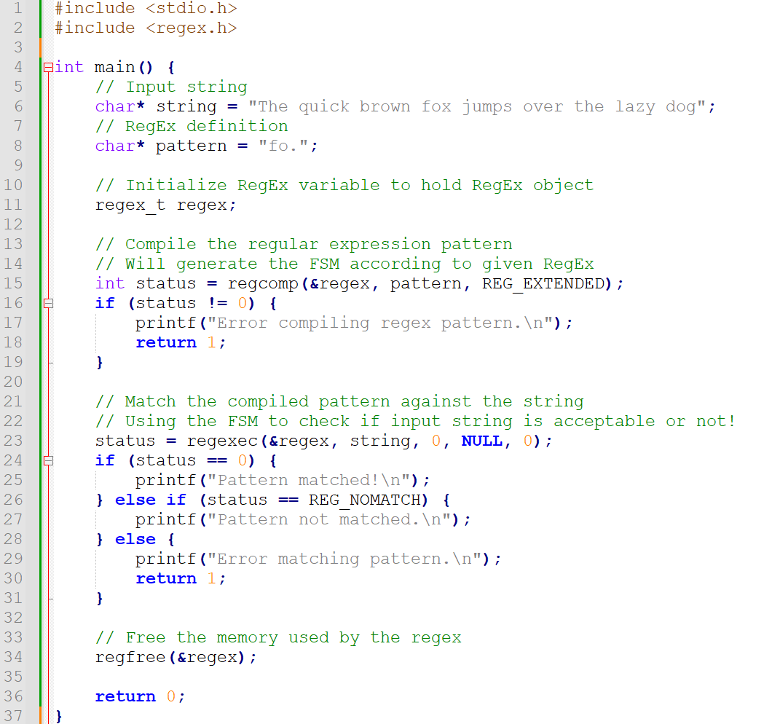

Slide 64
More stuff about RegEx
For curiosity, but probably very niche in practice.

Slide 65
The curly braces in RegEx
In RegEx, the curly braces ({}) are used to specify how many times a preceding element should be matched.
{n} matches the preceding element exactly n times,
{n,m} matches the preceding element between n and m times (inclusive),
and {n,} matches the preceding element at least n times.
For instance,
a{3} matches the string "aaa", but not "aa" or "aaaa".
a{2,4} matches the string "aa", "aaa", or "aaaa", but not "a" or "aaaaa".
\d{2,} matches any string that contains at least two digits, such as "123", "45", or "6789".

Slide 66
The boundary \b
Definition (The boundary \b):
The metacharacter \b matches a word boundary.
It is a position between a word character and a non-word character, or between a non-word character and a word character.
For example, the regex pattern \bcat\b matches the word "cat" when it occurs on its own as a separate word, but not when it appears as part of another word like "category" or "scat":
“The cat is black and white” works, so does “I love my cat”.
“The category of my work is computer science” does not.
The \b can then be used to recognize while in “while(something…)”.

Slide 67
Some additional practice
From past year homeworks

Slide 68
You are working for a survey company in Singapore. You will be sending forms to a vast quantity of SG-based users, asking for their names and phone numbers, along with many survey questions regarding various topics. Every survey form will require the participants to enter their phone number, as a string of digits.
Some algorithm will be used to remove all the whitespaces in the string entered by the user for you, and you should expect one of the three string formats below after the string has been cleaned. After cleaning the strings will look like “63036600”, “+6563036600”, or “006563036600”. Possibly with other digits than those shown. Question: Can you write a RegEx for checking if the phone number consists of eight digit and maybe a country code +65 or 0065 that might have been added to the phone number?
We expect the users to enter only digits, no phone numbers with more than 8 digits (unless country codes are used), and no country codes other than +65 or 0065.
A phone number not using 8 digits (before a country code is added) is invalid.
Any other country code than +65 or 0065 should be rejected.
We shall only check for valid characters: it is ok if our RegEx does not catch a phone number +6500000000, which is obviously fake.

Slide 69
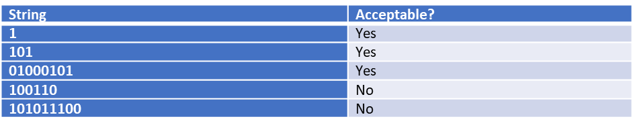
Let us consider strings consisting of 0s and 1s only.
We would like to check for strings that have the same digit in their first, third, fifth, etc. location. Have a look at the table below for some examples of acceptable and not acceptable strings.
Question: Your friend Chris claims that it is impossible to describe this pattern using a RegEx. Do you agree with him and can explain why this is not possible? Or can you provide a RegEx that works for this task and prove Chris wrong?

